Slide 1

Project Zero:
A CLI Banking Application
A Brief Tour

Slide 2


Technologies Used
.NET Core 8
Entity, Spectre
C#, Microsoft SQL
Visual Studio Code
SSMS
Key
Frameworks: .NET Core 8, Microsoft Entity, Spectre
Languages: C#, SQL
Tools: Visual Studio Code, SQL Server Management Studio

Slide 3
Streamline Banking Operations
Administrator
- Perform CRUD Operations
- Reset Customer Passwords
- Approve Requests
Customer
- Check Account Details
- Perform Transactions
- Check Transaction History
- Request Checkbooks
Security
- User Authentication
- Password Encryption
- Input Validation

Slide 4
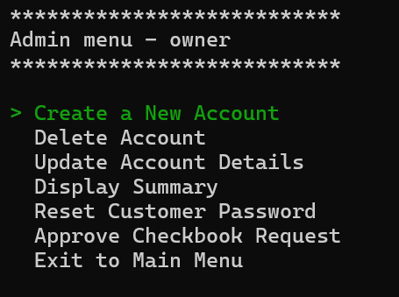
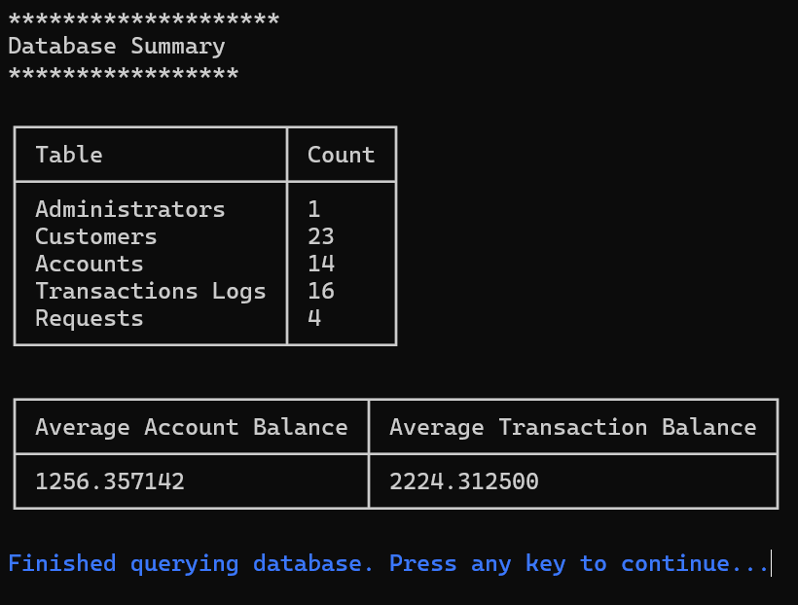
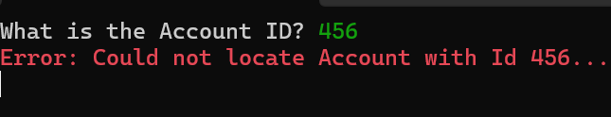
A Vertical Slice - Admin
The Admin will navigate a series of menus to perform CRUD operations to manage customers, accounts, and also fulfill user requests.

Slide 5
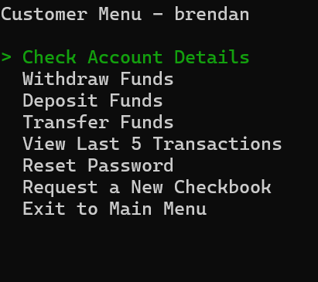
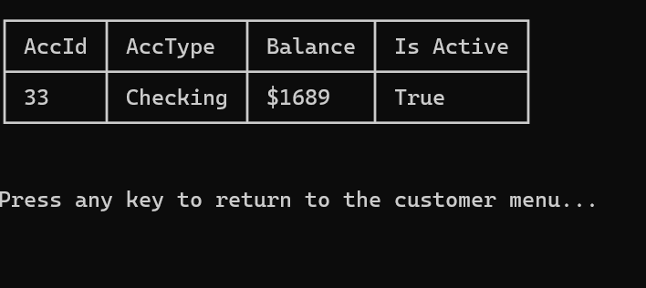
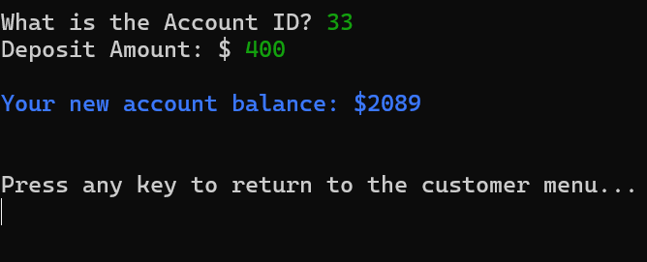
A Vertical Slice - Customer
The Customer can use the menu to deposit or withdraw funds, reset their password, and view account details.

Slide 6
What’s Coming
Granular Controls Features to enable users to perform more more fine-tuned operations
Refined Interface Enhanced UI to deliver a superior user experience
Improved Error Handling Don’t restart from the beginning; keep going until it’s just right

Slide 7

It means a lot to share my project, so
THANK YOU FOR YOUR
TIME AND ATTENTION
LinkedIn: linkedin.com/in/brendanrousedev/
GitHub: github.com/brendanrousedev
Email: brendanrousedev@gmail.com

